Slide 1

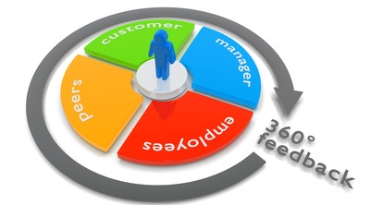
Leadership Module
Introduction to the 360-Degree Feedback
THM Business School
by
Prof. Dr. Waldemar Pelz

Slide 2
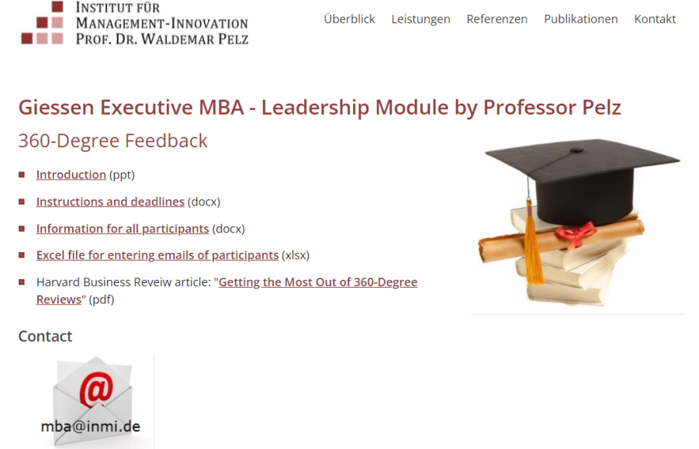
www.management-innovation.com/mba

Slide 3
Contents of the Leadership Module
3
Perspectives
Career
Motivation
Objectives
1
Effective
Communication
2
4
Identity & Profile
Learning & Actions
Core Competencies (360°)
Personality Profile
Willpower/Energy
EQ/Stress
Personal Development Plan
(Grading)

Slide 4

The Importance of Feedback
„You simply cannot manage people to better performance if you do not give candid, consistent feedback“
(Jack Welch)

Slide 5
Traditional Feedback Versus 360°- Feedback
Traditional Feedback
360-Degree Feedback
(One) Superior
(More)
Superiors
Manager
Colleagues
Manager
Self
Assessment
Employees
Employees
Nr. 5

Slide 6
Example: Leadership Competencies (One Source)
Being a
role model
Goals and
perspectives
Support and
learning
Relationships
Result
Orientation
Entre-
preneurship

Slide 7
Example: Leadership Competencies (More Sources)
Self-Image
Public Image
Being a
role model
Goals and
perspectives
Support and
learning
Relationships
Result
Orientation
Entre-
preneurship

Slide 8
Short-Term Personal Development Plan
My major strengths
Behaviors | What will I do to strengthen these strengths? | Date
1. Being open to criticism … 2. Communicating values … 3. Gaining resepct by … 4. Aligning words and deeds… 5.
My major weaknesses
Behaviors | What will I do to overcome these weaknesses? | Date
1. Minimize political behavior… 2. Improve work atmosphere… 3. Setting priorities… 4. Showing courage… 5.
What can I change immediately with
little effort
What can I change immediately with
little effort
Nr. 8

Slide 9
Long-Term PDP: Business and Other Life Areas
Competencies | Which competencies are needed to achieve my long-term goals?
 | Business and Career | Other Life Areas
Analytical Thinking
Conflict Management
3. Initiative
4. Entrepreneurship
5. Creating Trust
Other Competencies
Ph
So
Et
Me
Career Goals
Personal Goals
S
P
KPI
C
Business Goals

Slide 10

Competencies in the 360-Degree Feedback
Outward Appearance
Analytical Thinking
Taking Initiative
Goal-, and Result Orientation
Communication Skills
Team-based Skills
Decision Making and Problem Solving
Conflict Management
Creating Trust and Personal Relations
Emotional Intelligence

Slide 11
www.managementkompetenzen.de
https://pelz.fuehrungskompetenzen.net/form/ident/Basic

Slide 12
360-Degree Instructions (Overview)
Download the file „360-Participants.xlsx“ from the site:
www.management-innovation.com/mba
Fill-in your and your feedback partners‘ names and emails, and send it to: mba@inmi.de (for deadlines see separate information)
You and your partners get access to the online questionnaire, to be filled in
until (see separate checklist) …
Inform your feedback partners (superiors, colleagues, direct reports) in advance:
    Anonymity – except superiors if there are less than three of them
    Deadline …
    Time needed: 10 to 15 minutes
    What happens with results
All files (and other information) to be downloaded from:
www.management-innovation.com/mba
For background information see: www.360-grad-feedback.net

Slide 13
www.management-innovation.com/mba

